Slide 1
Networking

Slide 2
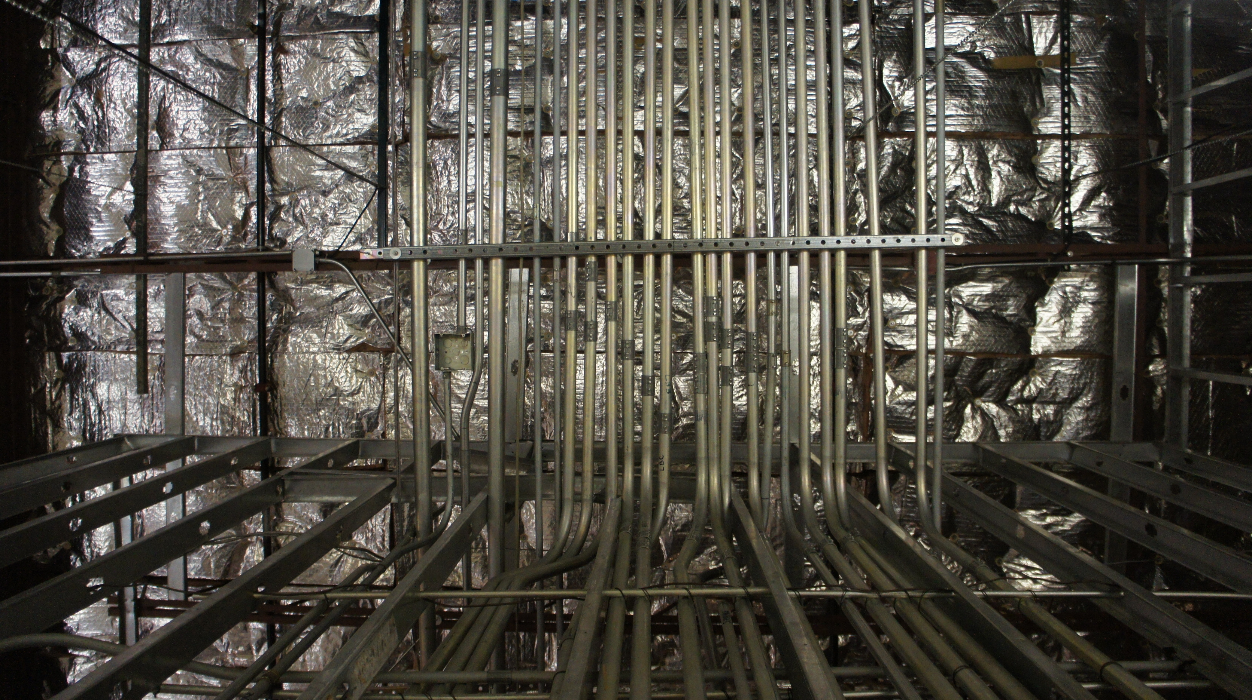
Notes:
The internet is not really just a series of tubes – but it’s not far off – let’s look at it from a nuts and bolts view.
There are now billions (at least 460 billion!) of connected devices (including toasters, fridges, desktop phones, picture frames and bed mattresses) that are running network applications. Systems that sit on the end of connections are called “hosts”.
Between them all are communication links of a huge variety: fiber, copper, radio, satellite
These all share a common transmission rate measure we call bandwidth.
The Internet itself is a “network of networks” – there is a series of ISPs that are interconnected
Those networks are managed by protocols that control the sending and receiving of messages:
TCP, IP, HTTP, Skype, 802.11 (wifi).
Protocols are controls by standards: RFCs (Request for comments) from the IETF Internet Engineering Task Force.
Not all RFCs are standards, but they form the backbone of what we call the internet today.

Slide 3
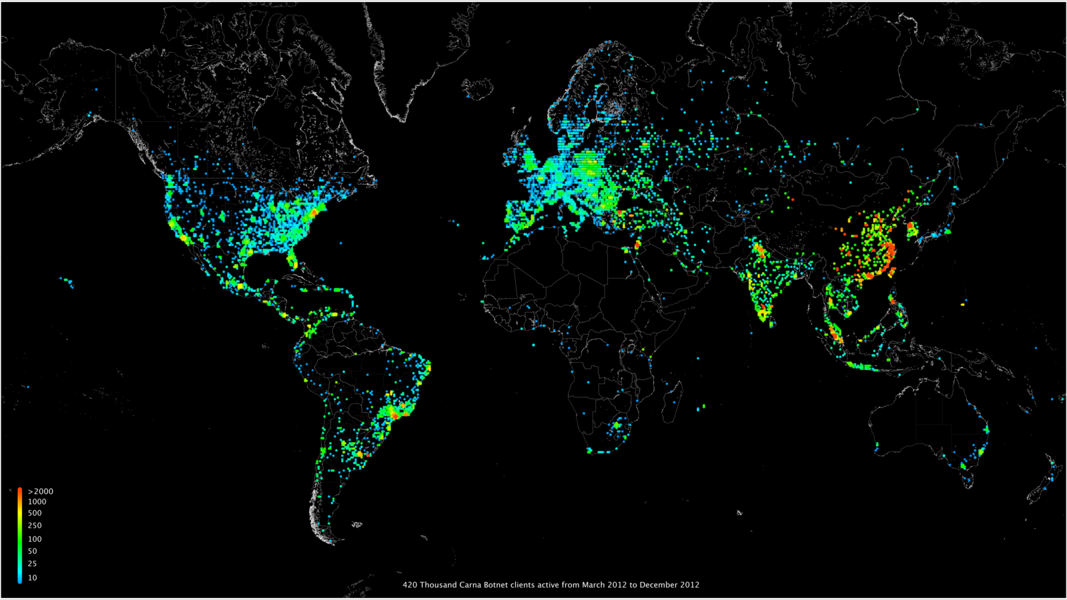
Notes:
We can also look at it from a services view:
It’s the infrastructure that provides services to applications: The web, VoIP, email, games, e-commerce, social networks…
We also get access to programming interface to apps – hooks that allow sending and receiving app programs to “connect” to the internet
It provides service options analogous to the post office (delivery of packets of information to specific addresses).

Slide 4

Protocols define format, order of messages sent and received among network entities and actions taken on message transmission or receipt.
Notes:
What’s a protocol?
Humans have protocols – think about polite conversation or chitchat:
“What’s the time?”
“I have a question”
“Hi, I’m Chris, what’s your name?”
… so specific messages are sent
And specific actions are taken when messages are received.
Network protocols work in a similar way, but they’re about communicating between machines, not humans
All communication activity on the internet is governed by protocols (even the “dark web” is driven by HTTP and TOR protocols).
Protocols define format, order of message sent and received among network entities and actions taken on message transmission or receipt.

Slide 5

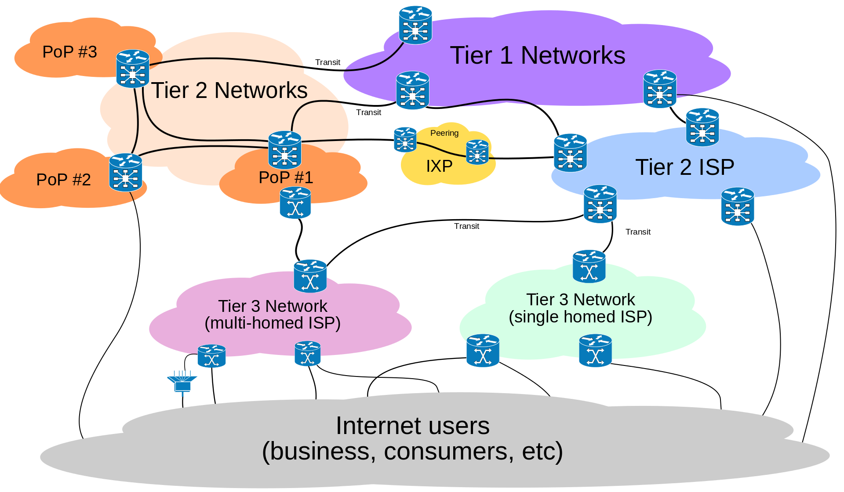
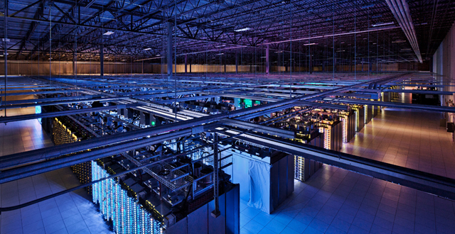
Notes:
So at the edge of the network, we have hosts and servers
Servers often reside in data centers (huge air conditioned buildings that contain a whole lot of server racks) – this is one run by google.
Between them are access networks and physical media – wired and wireless communication links
In the network core reside interconnected routers that are part of the network of networks.
So we have smaller networks that connect to ISPs (tier 3) that themselves connect to larger service providers and data networks (Tier 2 and 1)
Home networks are fairly straight forward – you have your cable / dsl model that connects to your ISP which sometimes act as a router / firewall for the rest of your connected devices (wired or wireless).
Somewhere larger, like offices or a university work at an enterprise level, they may contain a set of servers – email, web etc. As well as a host of devices all linked by a number of switches. Generally much faster transmission rates than you see in home networks.

Slide 6

Notes:
So devices at the edge of the network are “hosts” they send packets of data.
The host takes the message from an application and breaks it into smaller chunks, known as packets (hence why you see phrases such as packet loss in games) that are of length L bits.
It then transmits each packet into the access network at a given transmission rate ( R ), which is then sent on dependant on the link transmission rate (or bandwidth).
The packet transmission delay amount can be calculated:
Time needed to transmit an L-bit packet into the link = L (bits) / R (bits / sec)

Slide 7

Notes:
At the network core sits a mesh of interconnected routers
Which use packet-switching:
The hosts break application-layer messages into packets
Routers forward packets from one router to the next, across links on path from source to destination.
Each packet is transmitted at the full link capacity of the connection.
It takes L/R seconds to transmit L-bit packet into link at R bps
Entire packet must arrive at router before it can be transmitted to next link.
This generates an end-to-end delay which is roughly 2 L/R (but assuming zero propagation delay).
If the arrival rate (in bits) to the link exceeds the transmission rate then packets will either queue, waiting to be transmitted or be dropped if the memory fills up (the queue gets full).
So the key functions of the network core are to route packets – determine the source to destination route taken by packets and to forward packets on along that route. (hence, routers).

Slide 8
Notes:
Internet structure:
So end systems connect to the Internet via access ISPs
residential, company and universities
Access ISPs must in turn be interconnected
So any two hosts can send packets to each other
Result network of networks is very complicated
The evolution was driven by economics and national policies.
How do we connect millions of ISPs together?
Directly connecting does not scale – N^2 connections!
So we could connect them all to a single global ISP – with economic agreements between the customer and provider ISPs.
But that produces competition, so we end up with multiple global ISPs that need to be connected. This is achieved via IXPs (Internet exchange points) and regional networks that connect a number of access ISPs to the global ISPs.
And then across and between all that are networks that sit outside the ISP structure, but connect to it – content delivery networks (google, Microsoft, Amazon etc). These sit alongside tier 1 isps!

Slide 9
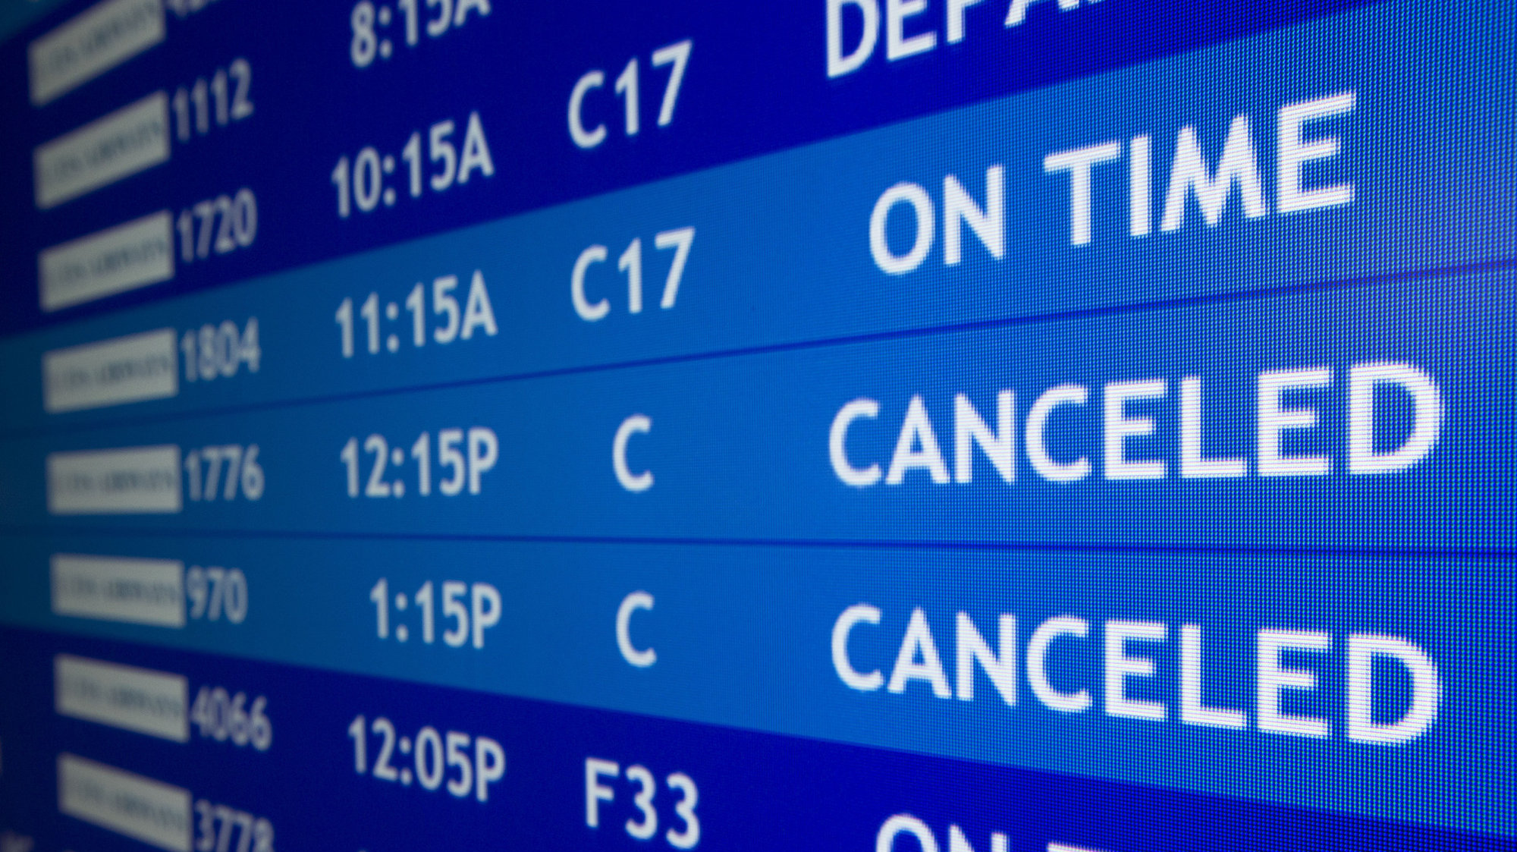
Notes:
So we briefly mentioned packet loss and delay earlier.
We said that packets are queued in router buffers if the packet arrival rate excessed the output link capacity.
They are dropped from memory completely if the buffer (queue) is full.
There are four sources of packet delay:
Nodal processing
Check bit errors, Determine output link, Typically < millisecond
Queueing delay
Time waiting at output link for transmission, Depends on congestion level of router
Transmission delay
L packet length (bits), R link bandwidth (bps), L/R
Propagation delay
D length of physical link, S is propagation speed, d/s
Transmission delay and propagation delay are very different values!
Think about a caravan of 10 cars going through a series of toll booths 100 miles apart – they “propagate” at 100 m/hr, the toll booth takes 12 seconds to service each car (bit transmission time)
Time to push entire caravan through the toll booth onto the motorway = 12*10 = 120 seconds
Time for last car to propate from the 1 booth to the last = 100km/(100km/hr) = 1 hour
It’s going to take 62 minutes for all the cars to are through the first booth and waiting at the second booth.
Suppose we speed the cars up, so they travel at 1000 miles an hour and it takes a minute for each booth to service a car. After 7 minutes, the first car will arrive at the second booth while there are still three cars at the first booth waiting to be processed.
Can observe this happening for real with traceroute

Slide 10

Notes:
So the buffers (queues) at every step of the route between source and destination have finite capacity.
Packets that arrive to a full queue are dropped (completely lost).
Lost packets *may* be retransmitted by the previous node, source system or not at all.
That depends on the protocol used and so the decision that drives the protocol choice has to consider how important it is that all packets be received.

Slide 11

ticket (purchase)
baggage (check)
gates (load)
runway takeoff
airplane routing
ticket (complain)
baggage (claim)
gates (unload)
runway landing
airplane routing
ticket (purchase)
baggage (check)
gates (load)
runway (takeoff)
airplane routing
ticket (complain)
baggage (claim
gates (unload)
runway (land)
airplane routing
ticket
baggage
gate
takeoff/landing
airplane routing
airplane routing
airplane routing
departure
airport
intermediate air-traffic
control centers
airplane routing
arrival
airport
Notes:
Networks are complex with many “pieces”:
hosts, routers, links of various media, applications, protocols, hardware and software.
To achieve some level of organization, we need some sort of sensible method.
Consider the organisation of air travel – a series of steps that lead from purchasing a ticket, to checking your baggage to the plane taking off, routing through the air space, landing and you landing and claiming your baggage back again.
If we layer those steps, we can start to see an organization appear
Each layer implements a service
Via it’s own internal layer actions
These rely on services provided by layers below
Layering lets us work with complex systems
Explicit structure allows identification of relationships between the pieces of the system
Modularization eases maintenance, updating the system is easier.
- change of implementation of a layers service is transparent to the rest of the system

Slide 12
application
transport
network
link
physical
application
presentation
session
transport
network
link
physical
Notes:
Networks are organised in layers (otherwise known as the protocol stack)
The Internet Protocol (IP) stack is organised like this:
At the top level, we have the application layer: supporting network applications FTP, HTTP, SFTP, SSH etc.
Transport: process – process data transfer (TCP, UDP)
Network: routing of datagrams from source to destination (IP, routing protocols)
Link: Data transfer between neighbouring network elements (Ethernet, wifi)
Physical: bits “on the wire”
The ISO / OSI reference model takes that protocol stack and adds two extra layers:
Presentation: Allows applications to interpret the meaning of data (e.g., encryption, compression, machine specific conventions)
Session: Synchronization, checkpointing, recovery of data exchange.
These services, if needed, must be implemented in an application because the Internet stack is missing them.

Slide 13

Notes:
We’ve covered a lot of material:
We got an overview of the internet and an idea of just how big it is.
We talked about what a protocol is
We went over what makes up the network edge, the network core and the access network
We covered performance factors, in terms of packet loss and delay.
And we topped it off with a lovely slice of cake by talking about layering and service models.
The important take away from this is that most of the stuff you will work with will be in the top of the stack, the application layer – and it’s there that you first assignment sets you.
You need to write a protocol specification for a client / server chat system. A client should be able to connect to a server, specify a name, connect to a channel / room and then talk with other people in that channel / room.
The server needs to track all the rooms and all the users, route messages to the correct rooms / users while handling all incoming connections and client activity.
You will need to consider a communication protocol that allows the chat activity to take place – what commands can the client send? What responses does the server make? Error codes, the works.

